Slide 1
Progress Report: Nakuja N3
AIRFRAME TEAM • 08.01.2023

Slide 2
Overview
Recent Progress:
Revision of Launch lug and launch rail design #6
Test fabrication of Fibreglass airframe
Yet to be finalised:
Design of fin alignment jig
Fabrication of fin alignment jig
Finalising on fibreglass body tube fabrication

Slide 3
Progress – Redesign of Launch rail and launch lug
Challenge:
The initial launch lug and launch rail design involved machining a dovetail slot into the frame of the rail to offer adequate support to the rocket off the rail.
The biggest challenge with this design was the difficulty in machining the slot due to the length of the rod, which made it a challenge to machine the piece on both the CNC and universal milling machines.
Development:
A new design was opted for whereby the material to be used for the rail would be sourced from the supplier with an already existing slot, negating the need to machine the rail slot in-house.
This would also reduce the total machining time for the lug and rail.

Slide 4
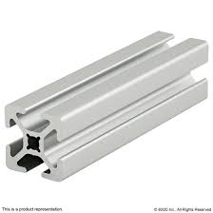
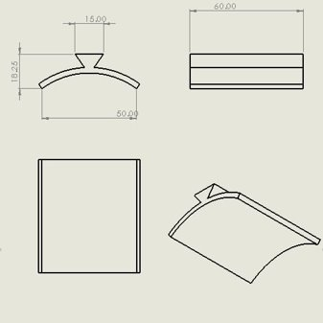
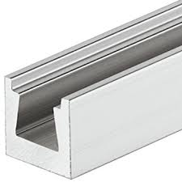
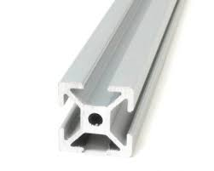
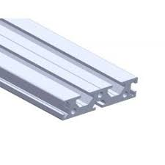
Launch lug and launch rail designs
Initial designs for the rail and lug
Proposed Rail design

Slide 5

Calculation for the launch rod height required
The wind conditions in Isiolo range from 3-5m/s in the mornings and increase to 6-7 in the evenings where the winds are high. A tall launch rod is desired to both stabilize the rocket in both windy and calm conditions. If we have:
where:
a = 32.17 [(fi/w)-1]
fi/w = Initial thrust to weight ratio
fi = Average initial thrust while the rocket is accelerating up the launcher (pounds)
w = Weight of the rocket at launch (pounds)
vr = velocity required for stability, ft./sec.
The -1 is for gravity

Slide 6
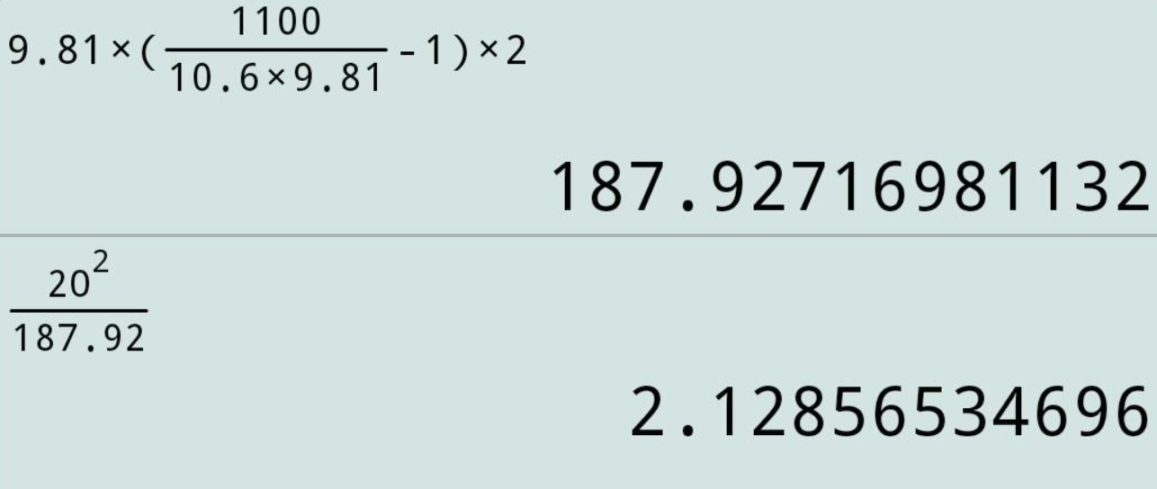
Given Thrust T=1100N, W=10.6Kg
A good rule of thumb is to have a velocity of 4times the wind speed to overcome any instability due to wind.
At Velocity of 20m/s, H=2.12m (5m/s wind)

Slide 7
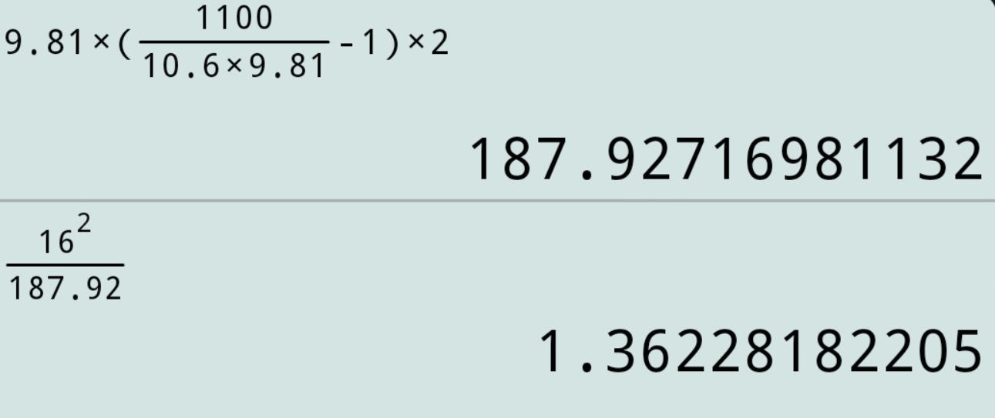
Velocity of 17m/s, H=1.4m (4m/s wind)
The height of the rod will thus range between 1.5 to 2m.
Since maximum velocity along the length of the rocket is at Mach 0.8, no additional shielding due to shock wave formation is needed.
The support base that will meet the weight requirements shall be designed after procurement of the launch rail.

Slide 8
Attention areas
Complete launch lug design according to the new rail design
Complete launchpad design
Complete fiberglass airframe fabrication

Slide 9
Goals for the next week
Expected delivery: 15th March 2023
Fabrication of airframe (Fibreglass) #20
Kickstart fabrication of aluminium airframe (#20)
Finish launch pad design after launch rail procurement

Slide 10
Are there any questions?

Slide 11
The End.
Thank you for your time.

